Slide 1
Chapter 25 | Southwest

Slide 2
Ch. 25 | Southwest
25
Key Message #1
Water Resources
Water for people and nature in the Southwest has declined during droughts, due in part to human-caused climate change. Intensifying droughts and occasional large floods, combined with critical water demands from a growing population, deteriorating infrastructure, and groundwater depletion, suggest the need for flexible water management techniques that address changing risks over time, balancing declining supplies with greater demands.

Slide 3
Ch. 25 | Southwest
25
Key Message #2
Ecosystems and Ecosystem Services
The integrity of Southwest forests and other ecosystems and their ability to provide natural habitat, clean water, and economic livelihoods have declined as a result of recent droughts and wildfire due in part to human-caused climate change. Greenhouse gas emissions reductions, fire management, and other actions can help reduce future vulnerabilities of ecosystems and human well-being.

Slide 4
Ch. 25 | Southwest
25
Key Message #3
The Coast
Many coastal resources in the Southwest have been affected by sea level rise, ocean warming, and reduced ocean oxygen—all impacts of human-caused climate change—and ocean acidification resulting from human emissions of carbon dioxide. Homes and other coastal infrastructure, marine flora and fauna, and people who depend on coastal resources face increased risks under continued climate change.

Slide 5
Ch. 25 | Southwest
25
Key Message #4
Indigenous Peoples
Traditional foods, natural resource-based livelihoods, cultural resources, and spiritual well-being of Indigenous peoples in the Southwest are increasingly affected by drought, wildfire, and changing ocean conditions. Because future changes would further disrupt the ecosystems on which Indigenous peoples depend, tribes are implementing adaptation measures and emissions reduction actions.

Slide 6
Ch. 25 | Southwest
25
Key Message #5
Energy
The ability of hydropower and fossil fuel electricity generation to meet growing energy use in the Southwest is decreasing as a result of drought and rising temperatures. Many renewable energy sources offer increased electricity reliability, lower water intensity of energy generation, reduced greenhouse gas emissions, and new economic opportunities.

Slide 7
Ch. 25 | Southwest
25
Key Message #6
Food
Food production in the Southwest is vulnerable to water shortages. Increased drought, heat waves, and reduction of winter chill hours can harm crops and livestock; exacerbate competition for water among agriculture, energy generation, and municipal uses; and increase future food insecurity.

Slide 8
Ch. 25 | Southwest
25
Key Message #7
Human Health
Heat-associated deaths and illnesses, vulnerabilities to chronic disease, and other health risks to people in the Southwest result from increases in extreme heat, poor air quality, and conditions that foster pathogen growth and spread. Improving public health systems, community infrastructure, and personal health can reduce serious health risks under future climate change.

Slide 9
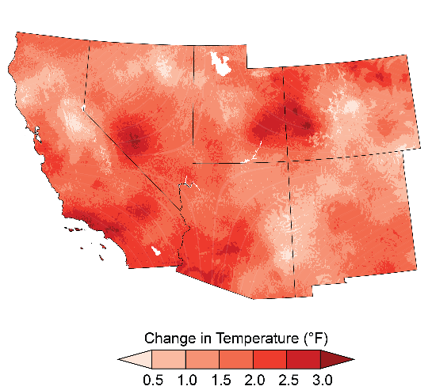
Fig. 25.1: Temperature Has Increased Across the Southwest
Ch. 25 | Southwest
Temperatures increased across almost all of the Southwest region from 1901 to 2016, with the greatest increases in southern California and western Colorado.²³ This map shows the difference between 1986–2016 average temperature and 1901–1960 average temperature.²³ Source: adapted from Vose et al. 2017.²³
Notes:
23: Vose, R.S., D.R. Easterling, K.E. Kunkel, A.N. LeGrande, and M.F. Wehner, 2017: Temperature changes in the United States. Climate Science Special Report: Fourth National Climate Assessment, Volume I. Wuebbles, D.J., D.W. Fahey, K.A. Hibbard, D.J. Dokken, B.C. Stewart, and T.K. Maycock, Eds. U.S. Global Change Research Program, Washington, DC, USA, 185-206. http://dx.doi.org/10.7930/J0N29V45

Slide 10
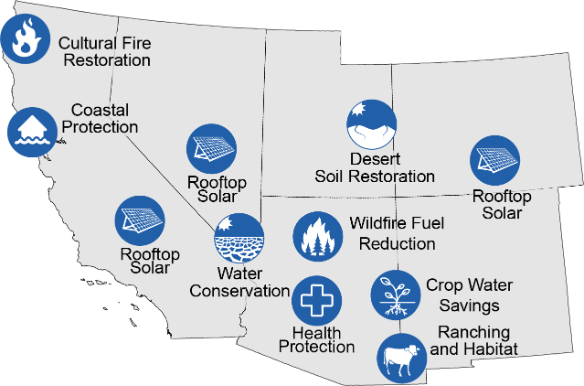
Fig. 25.2: Actions Responding to Climate Change Impacts and Vulnerabilities
Ch. 25 | Southwest
These examples illustrate actions that people, communities, and governments are taking in response to past impacts of climate change and future vulnerabilities. Coastal protection: In response to sea level rise and storm surge in San Francisco Bay, federal, state, and local agencies, supported by voter-approved funds, are restoring coastal habitats and levees to protect cities from flooding. Crop water savings: The risk of reduced food production increases as climate change intensifies drought. In the Gila River Basin, local government agencies have lined 15 miles (24 km) of irrigation canals to reduce seepage from the canals, saving enough water to irrigate approximately 8,500 acres (3,400 hectares) of alfalfa and other crops each year. Cultural fire restoration: Reintroduction of cultural burning by the Yurok Tribe in northern California reduces wildfire risks and protects public and tribal trust resources. Desert soil restoration: In Utah, transplanting native and drought-resistant microbial communities improves soil fertility and guards against erosion. Health protection: To reduce heat-associated injury and deaths on Arizona trails, the City of Phoenix and Arizona tourism organizations developed a campaign “Take a Hike. Do it Right.” Signs at trailheads and on websites remind hikers to bring water, stay hydrated, and stay aware of environmental conditions. Ranching and habitat: The Malpai Borderlands Group in Arizona and New Mexico integrates native plant and wildlife conservation into private ranching. Rooftop solar: The state governments of California, Colorado, and Nevada have enacted policies that support rooftop solar on homes, which reduces greenhouse gas emissions, improves reliability of the electricity generation system, and creates local small businesses and new jobs. Water conservation: Drought in the Colorado River Basin has reduced the volume of water in both Lake Mead and Lake Powell by over half. The United States, Mexico, and state governments have mobilized users to conserve water, keeping the lake above a critical level. Wildfire fuel reduction: In response to severe wildfires, the City of Flagstaff, Arizona, enacted a bond to fund reduction of fire fuels in forests around the town. Source: National Park Service.

Slide 11
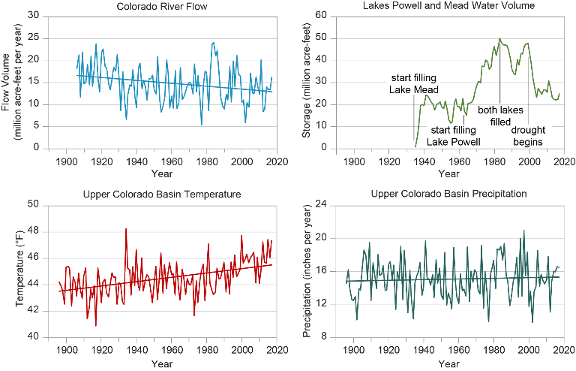
Fig. 25.3: Severe Drought Reduces Water Supplies in the Southwest
Ch. 25 | Southwest
Since 2000, drought that was intensified by long-term trends of higher temperatures due to climate change has reduced the flow in the Colorado River (top left), which in turn has reduced the combined contents of Lakes Powell and Mead to the lowest level since both lakes were first filled (top right). In the Upper Colorado River Basin that feeds the reservoirs, temperatures have increased (bottom left), which increases plant water use and evaporation, reducing lake inflows and contents. Although annual precipitation (bottom right) has been variable without a long-term trend, there has been a recent decline in precipitation that exacerbates the drought. Combined with increased Lower Basin water consumption that began in the 1990s, these trends explain the recently reduced reservoir contents. Straight lines indicate trends for temperature, precipitation, and river flow. The trends for temperature and river flow are statistically significant. Sources: Colorado State University and CICS-NC. Temperature and precipitation data from: PRISM Climate Group, Oregon State University, http://prism.oregonstate.edu, created 10 Jul 2012.

Slide 12
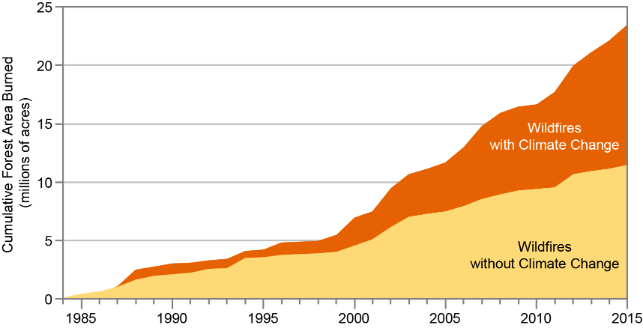
Fig. 25.4: Climate Change Has Increased Wildfire
Ch. 25 | Southwest
The cumulative forest area burned by wildfires has greatly increased between 1984 and 2015, with analyses estimating that the area burned by wildfire across the western United States over that period was twice what would have burned had climate change not occurred. Source: adapted from Abatzoglou and Williams 2016.⁷
Notes:
7: Abatzoglou, J.T. and A.P. Williams, 2016: Impact of anthropogenic climate change on wildfire across western US forests. Proceedings of the National Academy of Sciences of the United States of America, 113 (42), 11770-11775. http://dx.doi.org/10.1073/pnas.1607171113

Slide 13
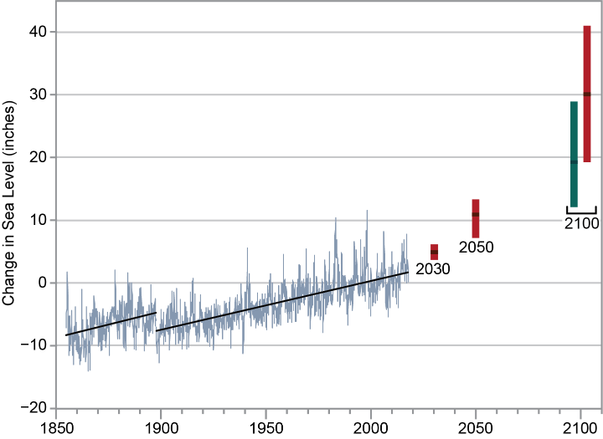
Fig. 25.5: Sea Level Rise
Ch. 25 | Southwest
Sea level rise increases risks to infrastructure. At the Golden Gate Bridge in San Francisco, California, the tidal gauge with the longest time series in the Western Hemisphere shows that sea level has risen nearly 9 inches (22 cm) since 1854 (gray line).^{236,295} In 1897, the tidal gauge was moved, which caused a slight shift downward of the numerical level but no change in the long-term trend (trends indicated by the blue line). The bars show models projections of sea levels under a higher scenario (RCP8.5; red) and a very low scenario (RCP2.6; green). Source: National Park Service.
Notes:
236: NOAA, 2017: Mean sea level trend: 9414290 San Francisco, California. National Oceanic and Atmospheric Administration (NOAA), National Ocean Service, Silver Spring, MD. https://tidesandcurrents.noaa.gov/sltrends/sltrends_station.shtml?stnid=9414290
295: Bromirski, P.D., R.E. Flick, and D.R. Cayan, 2003: Storminess variability along the California coast: 1858–2000. Journal of Climate, 16 (6), 982-993. http://dx.doi.org/10.1175/1520-0442(2003)016<0982:svatcc>2.0.co;2

Slide 14
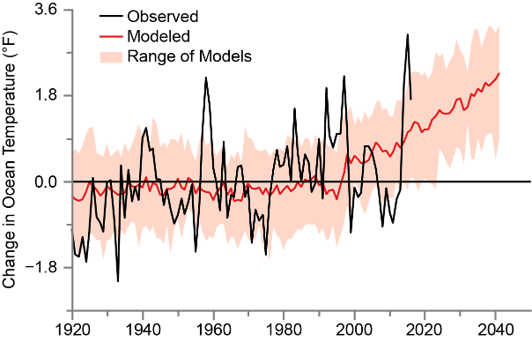
Fig. 25.6: Ocean Temperature Increase
Ch. 25 | Southwest
Ocean warming increases risks to fisheries and shellfish. The graph shows observed ocean temperatures of the California Current from measurements (black line); modeled temperatures, extended into the future under the higher scenario (RCP8.5; red line); and the range of 10% to 90% of the 28 models used (pink).^{254,296,297} Source: National Park Service and NOAA.
Notes:
254: Jacox, M.G., M.A. Alexander, N.J. Mantua, J.D. Scott, G. Hervieux, R.S. Webb, and F.E. Werner, 2018: Forcing of multiyear extreme ocean temperatures that impacted California Current living marine resources in 2016 [in "Explaining Extreme Events of 2016 from a Climate Perspective"]. Bulletin of the American Meteorological Society, 99 (1), S27-S33. http://dx.doi.org/10.1175/BAMS-D-17-0119.1
296: NOAA, 2017: NOAA Climate Change Web Portal. NOAA Earth System Research Laboratory, Boulder, CO. https://www.esrl.noaa.gov/psd/ipcc/
297: Rayner, N.A., D.E. Parker, E.B. Horton, C.K. Folland, L.V. Alexander, D.P. Rowell, E.C. Kent, and A. Kaplan, 2003: Global analyses of sea surface temperature, sea ice, and night marine air temperature since the late nineteenth century. Journal of Geophysical Research: Atmospheres, 108 (D14), 4407. http://dx.doi.org/10.1029/2002JD002670

Slide 15
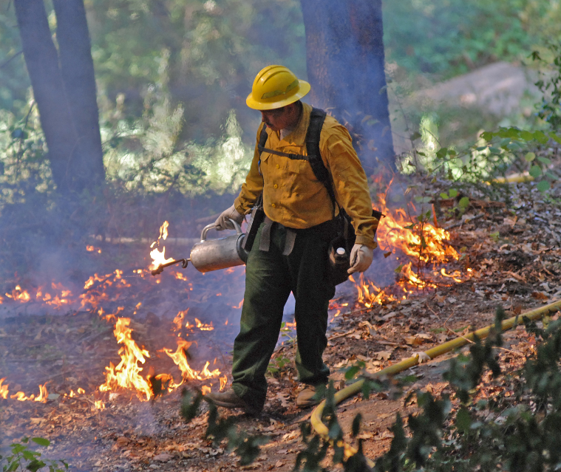
Fig. 25.7: Cultural Fire on Yurok Reservation
Ch. 25 | Southwest
Andy Lamebear, a Yurok Wildland Fire Department firefighter and Yurok tribal member, ignites a cultural burn on the Yurok Reservation. The tribe uses low- to medium- intensity fires to enhance the production of plant-based medicines, traditional basket materials, native fruits, and forage for wildlife. Cultural burning also reduces risks of catastrophic wildfire. Photo courtesy of the Yurok Tribe.

Slide 16
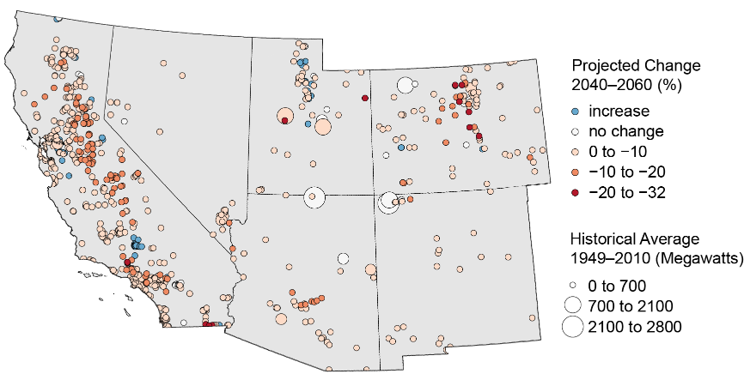
Fig. 25.8: Electricity Generation Capacity at Risk Under Continued Climate Change
Ch. 25 | Southwest
Under a higher emissions scenario (SRES A2¹⁷⁴), heat-induced reduction of energy efficiency and reduced water flows would reduce summer energy generation capacity across the Southwest region. These projected reductions would increase risks of electricity shortages. The map shows projected changes for the period 2040–2060 compared to the period 1949–2010. Source: adapted from Bartos and Chester 2015.³⁴⁶ Reprinted by permission from Macmillan Publishers Ltd.
Notes:
174: IPCC, 2007: Climate Change 2007: The Physical Science Basis. Contribution of Working Group I to the Fourth Assessment Report of the Intergovernmental Panel on Climate Change. Cambridge University Press, Cambridge. U.K, New York, NY, USA, 996 pp. http://www.ipcc.ch/publications_and_data/publications_ipcc_fourth_assessment_report_wg1_report_the_physical_science_basis.htm
346: Bartos, M.D. and M.V. Chester, 2015: Impacts of climate change on electric power supply in the western United States. Nature Climate Change, 5 (8), 748-752. http://dx.doi.org/10.1038/nclimate2648

Slide 17
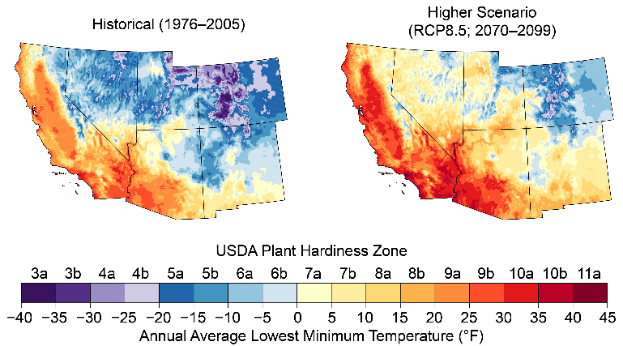
Fig. 25.9: Projected Shift in Agricultural Zones
Ch. 25 | Southwest
The U.S. Department of Agriculture plant hardiness zones indicate the cold temperature requirements of crops. Increases in temperature under the higher scenario (RCP8.5), would shift these zones northward and upslope, from the period 1976—2005 (left, modeled historical) compared to projections for 2070—2099 (right, average of 32 general circulation models). Sources: NOAA NCEI and CICS-NC

Slide 18
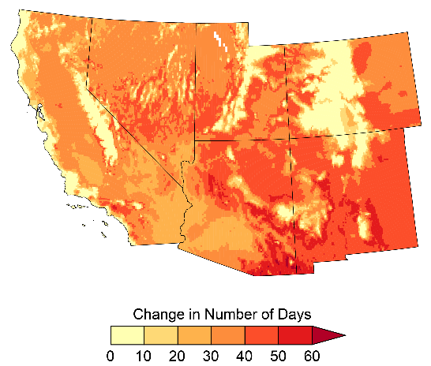
Fig. 25.10: Projected Increases in Extreme Heat
Ch. 25 | Southwest
Under the higher scenario (RCP8.5), extreme heat would increase across the Southwest, shown here as the increase in the average number of days per year where the temperature exceeds 90°F (32°C) by the period 2036–2065, compared to the period 1976–2005.²³ Heat waves increase the exposure of people to heat stroke and other illnesses that could cause death.³⁰ Source: adapted from Vose et al. 2017.²³
Notes:
23: Vose, R.S., D.R. Easterling, K.E. Kunkel, A.N. LeGrande, and M.F. Wehner, 2017: Temperature changes in the United States. Climate Science Special Report: Fourth National Climate Assessment, Volume I. Wuebbles, D.J., D.W. Fahey, K.A. Hibbard, D.J. Dokken, B.C. Stewart, and T.K. Maycock, Eds. U.S. Global Change Research Program, Washington, DC, USA, 185-206. http://dx.doi.org/10.7930/J0N29V45
30: USGCRP, 2016: The Impacts of Climate Change on Human Health in the United States: A Scientific Assessment. U.S. Global Change Research Program, Washington, DC, 312 pp. http://dx.doi.org/10.7930/J0R49NQX

Slide 19
Ch. 25 | Southwest
25
Chapter Author Team
Federal Coordinating Lead Author
Patrick Gonzalez, U.S. National Park Service
Chapter Lead
Gregg M. Garfin, University of Arizona
Chapter Authors
David D. Breshears, University of Arizona
Keely M. Brooks, Southern Nevada Water Authority
Heidi E. Brown, University of Arizona
Emile H. Elias, U.S. Department of Agriculture
Amrith Gunasekara, California Department of Food and Agriculture
Nancy Huntly, Utah State University
Julie K. Maldonado, Livelihoods Knowledge Exchange Network
Nathan J. Mantua, National Oceanic and Atmospheric Administration
Helene G. Margolis, University of California, Davis
Skyli McAfee, The Nature Conservancy (through 2017)
Beth Rose Middleton, University of California, Davis
Bradley H. Udall, Colorado State University
Review Editor
Cristina Bradatan, Texas Tech University

Slide 20
Ch. 25 | Southwest
25
Acknowledgments
Technical Contributors
Mary E. Black, University of Arizona
Shallin Busch, National Ocean and Atmospheric Administration
Brandon Goshi, Metropolitan Water District of Southern California
USGCRP Coordinators
Fredric Lipschultz, Senior Scientist and Regional Coordinator
Christopher W. Avery, Senior Manager

Slide 21
Gonzalez, P., G.M. Garfin, D.D. Breshears, K.M. Brooks, H.E. Brown, E.H. Elias, A. Gunasekara, N. Huntly, J.K. Maldonado, N.J. Mantua, H.G. Margolis, S. McAfee, B.R. Middleton, and B.H. Udall, 2018: Southwest. In Impacts, Risks, and Adaptation in the United States: Fourth National Climate Assessment, Volume II [Reidmiller, D.R., C.W. Avery, D.R. Easterling, K.E. Kunkel, K.L.M. Lewis, T.K. Maycock, and B.C. Stewart (eds.)]. U.S. Global Change Research Program, Washington, DC, USA. doi: 10.7930/NCA4.2018.CH25
https://nca2018.globalchange.gov/chapter/southwest
Notes:
https://nca2018.globalchange.gov/chapter/25/

